Slide 1
RLC Measurement Introduction

Slide 2
Overview
Introduction
Measurement Methods
Auto-Balancing Bridge (LCR)
Network Analysis (VNA)

Slide 3
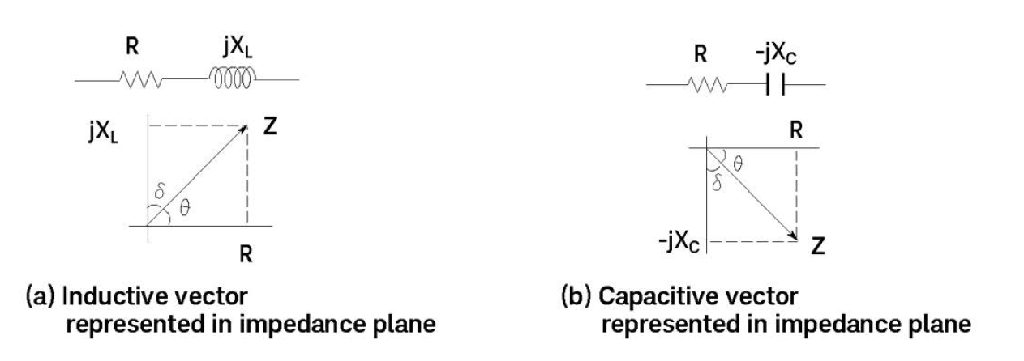
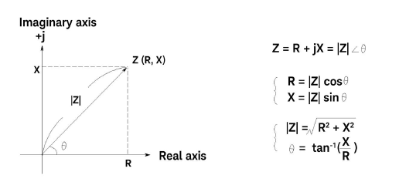
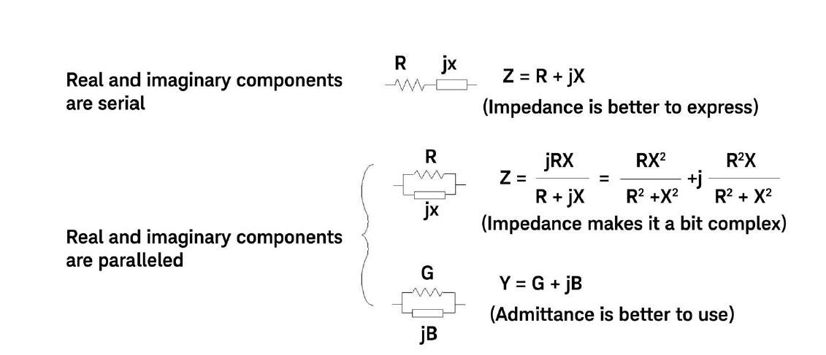
Introduction
Impedance (Z) is the total opposition to current flow in an AC circuit. Made up of Resistance R (real) and Reactance X (imaginary) elements at a given frequency. Commonly used to represent series circuits
Z = R +jX =|Z|∠θ
Admittance (Y) is the reciprocal of impedance, with G conductance and B susceptance. Commonly used to represent parallel circuits
Reactance (X)
X_{L} = Inductive, θ>0°
X_{C} = Capacitive, θ<0°

Slide 4
Measurement Methods

Slide 5
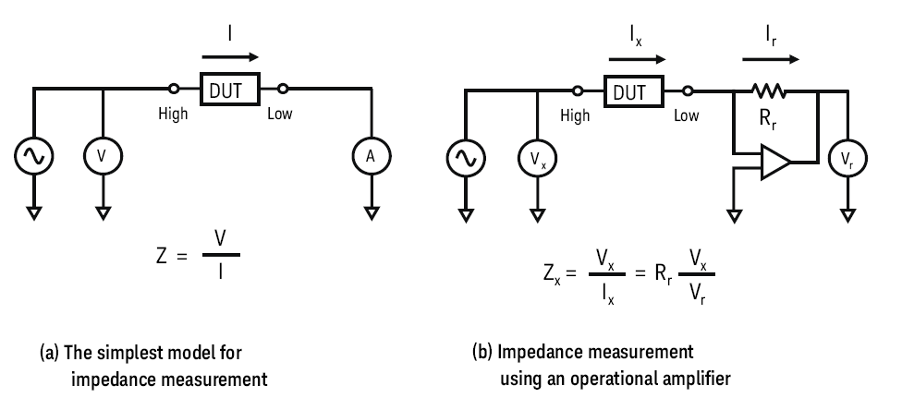
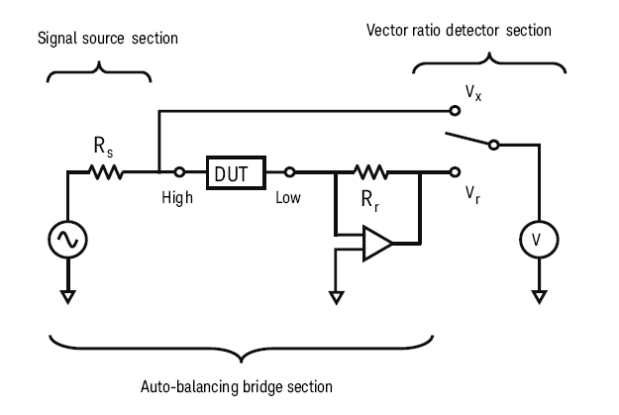
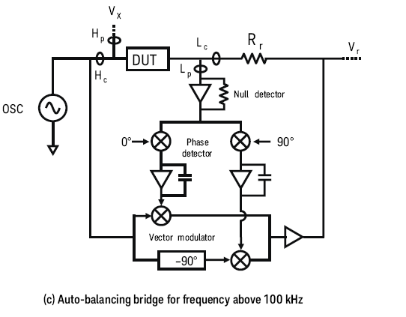
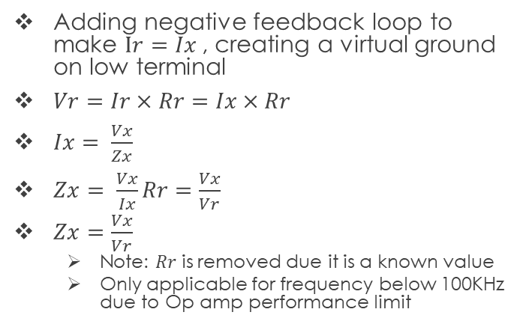

Auto-Balancing Bridge Method Working Principal
Using Z = V/I $Z= \frac{V}{I}$
Adding negative feedback loop to make $Ir=Ix$, creating a virtual ground on low terminal
$Vr=Ir×Rr=Ix×Rr$
$Ix= \frac{Vx}{Zx}$
$Zx= \frac{Vx}{Ix}Rr=\frac{Vx}{Vr}$
$Zx=\frac{Vx}{Vr}$
Note: $Rr$ is removed due it is a known value
Only applicable for frequency below 100KHz due to Op amp performance limit
Auto-Balancing bridge consists of null detector, 0°/90° phase detectors, vector modulator
For frequency up to 120 MHz
Auto Balancing Bridge using 1 Voltmeter

Slide 6
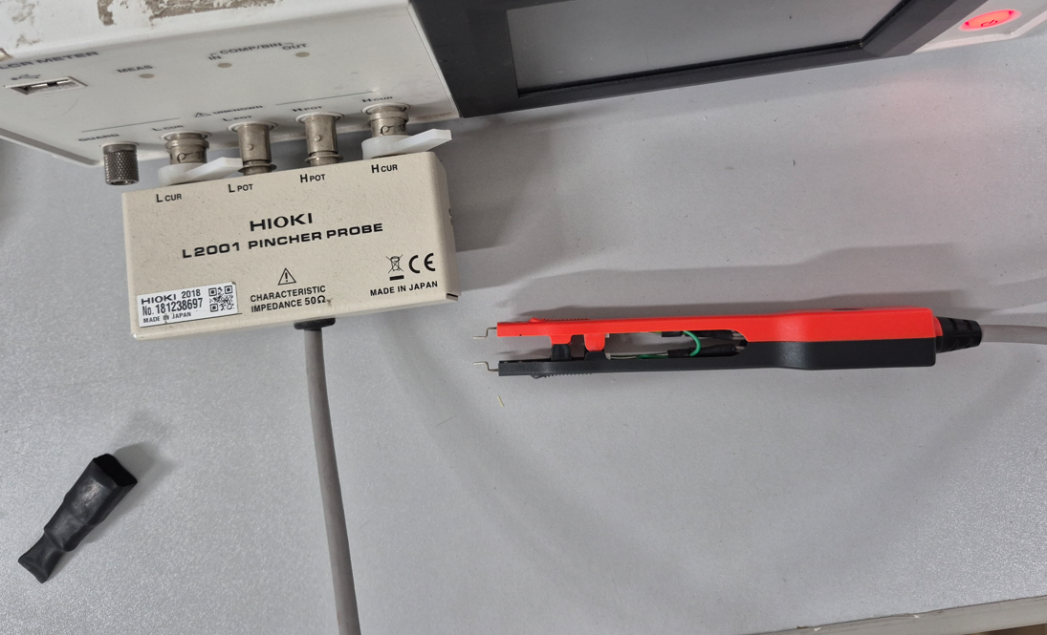
Auto Balancing Bridge Method (LCR Meter)
Using HIOKI IM3536 LCR meter
Using L2001 Pincher Probe
For general purpose measurements
Measurement range: DC, 4Hz ~ 8MHz
Advantages:
Easier to use
Faster setup
Disadvantages:
Only for LF to HF

Slide 7
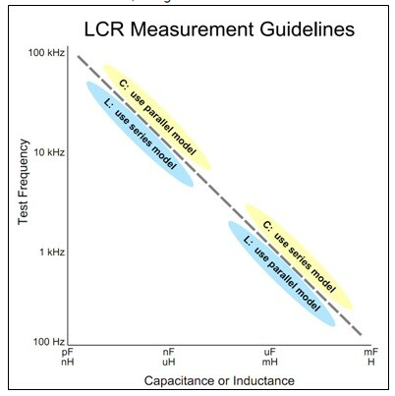
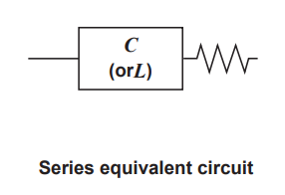
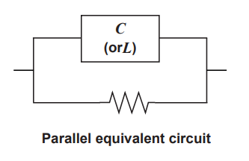
Series Vs Parallel measurement
Series measurement
Low Z (<100 Ω)
Large Capacitance
Low inductance
Parallel Measurement
High Z (>10K Ω)
Small Capacitance
High Inductance

Slide 8
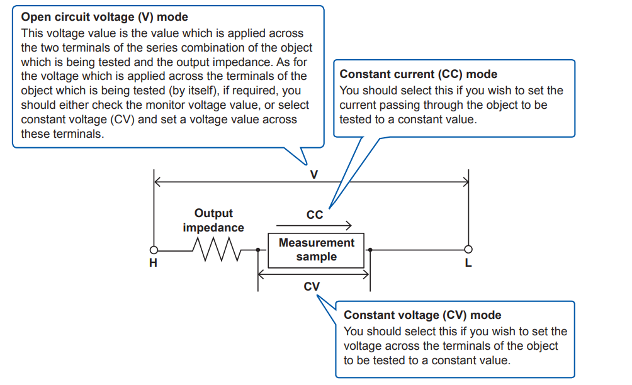
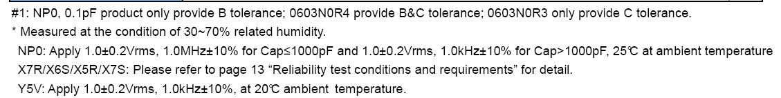
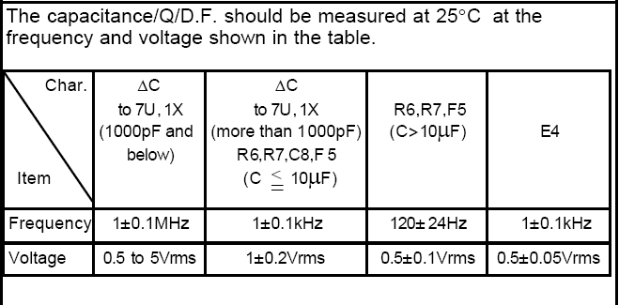
Measurement Signal Mode
Open circuit voltage (V) mode
Used for general measurement
Constant current (CC) mode
To measure DUT under a constant current
Constant voltage (CV) mode
To measure DUT under a constant Voltage
Typical components are measured in open circuit voltage mode.
Refer to the datasheet for the measurement conditions
Examples:

Slide 9
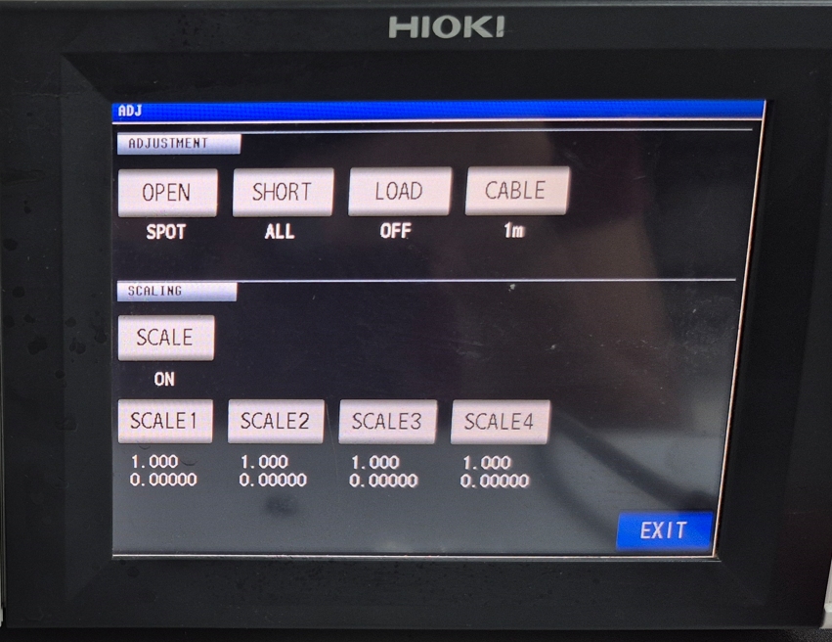
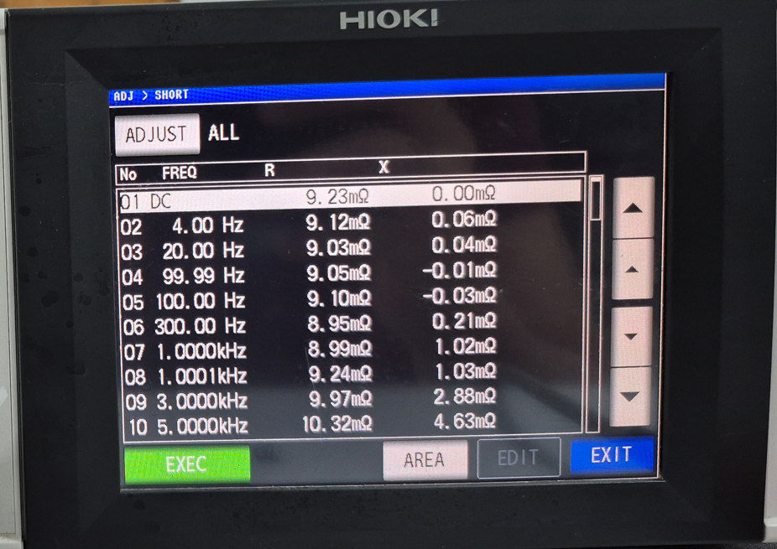
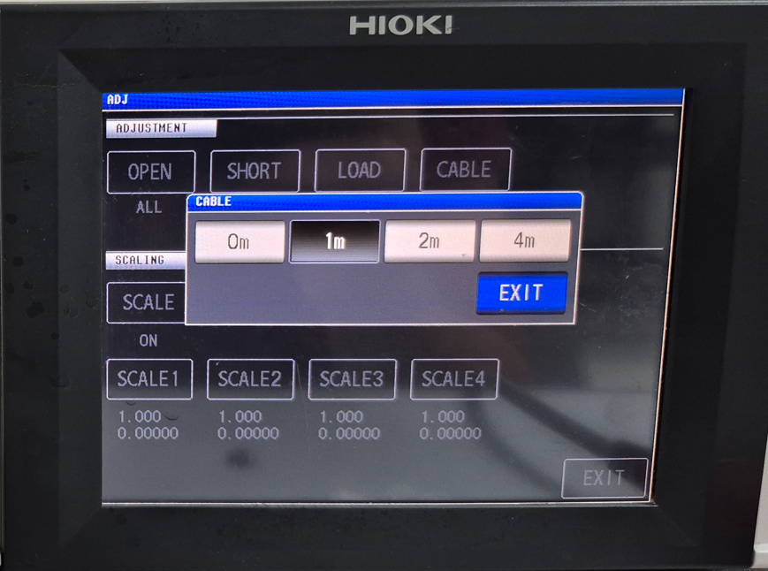
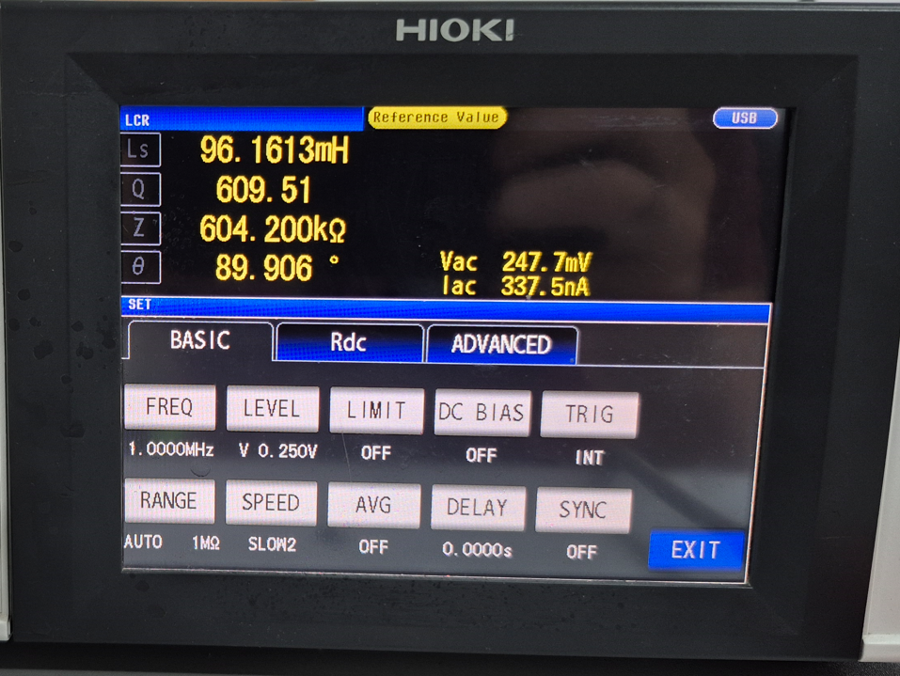
HIOKI IM3536 setup
Do Short and Open adjustment
Can do SPOT calibration for specific frequency or calibrate all frequency
Set cable length
Set measurement parameter (Frequency, Level, Range, etc)
Set measurement display (Q, Z, Lp, Cs, Rs, etc)
Calibration screen
Spot calibration
Cable length
Measurement parameter

Slide 10
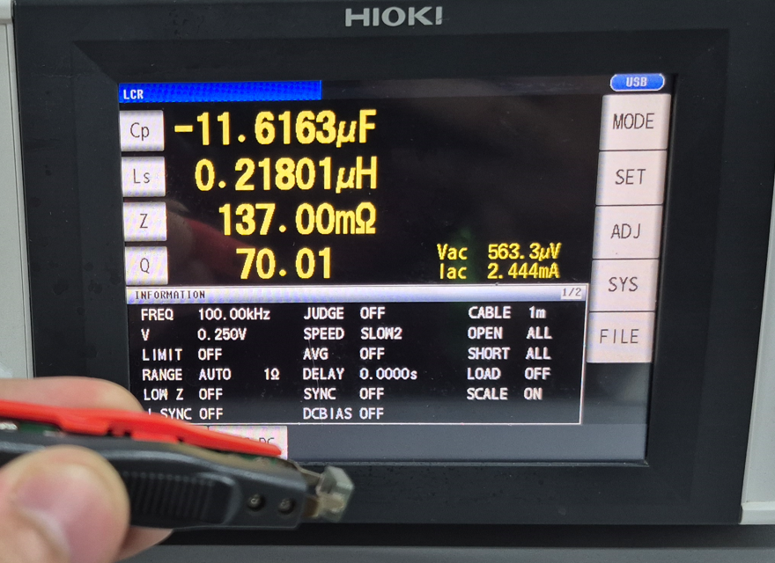
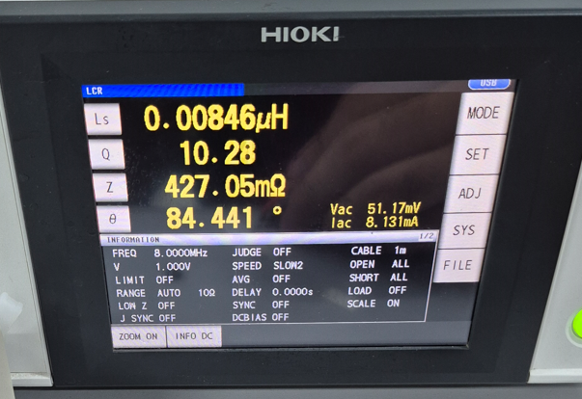
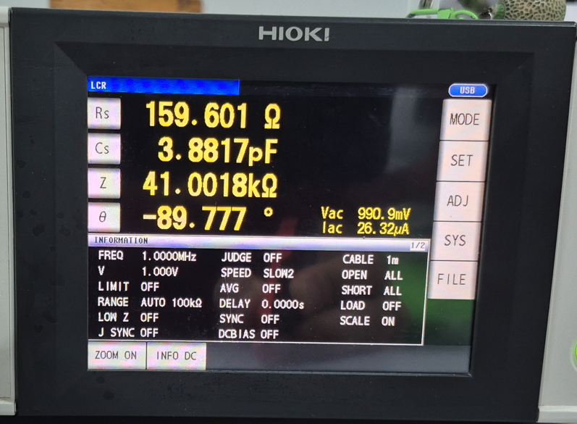
LCR Meter – Measurement Results
Measured 3 components,
LF 0.2uH Inductor (100KHz)
Measured 0.218 uH
Error rate of 9%
HF 3.6nH Inductor (250MHz)
Measured at 8MHz
Measured 8.46nH
Error rate of 135%
HF 3.9 pF Capacitor (1MHz)
Measured at 1MHz
Measured 3.881pF
Error rate of -0.48%
0.2 uH
3.6nH
3.9pF

Slide 11
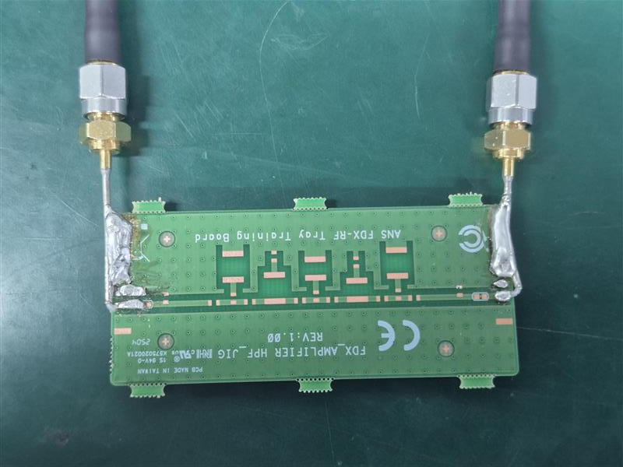
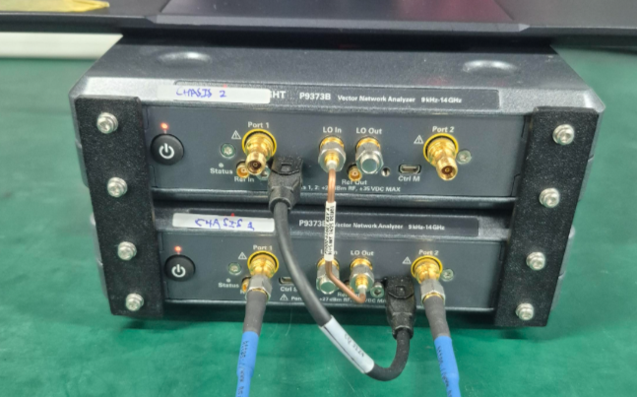
Network Analysis Method (VNA)
Measuring by using return loss and smith chart
Using VNA and fixture board
Advantages:
Can measure from low frequency to RF depending on the VNA
Disadvantages:
Need to be calibrated for each frequency or value
Harder to do measurement (compared to LCR meter)
Keysight VNA P9373B
Fixture board

Slide 12
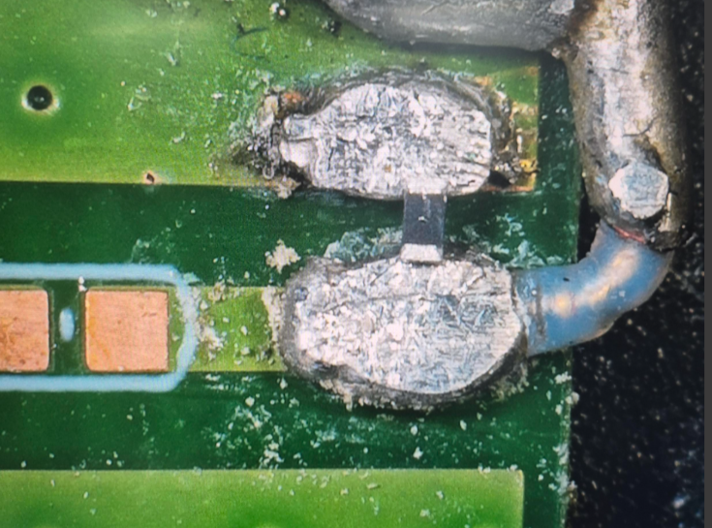
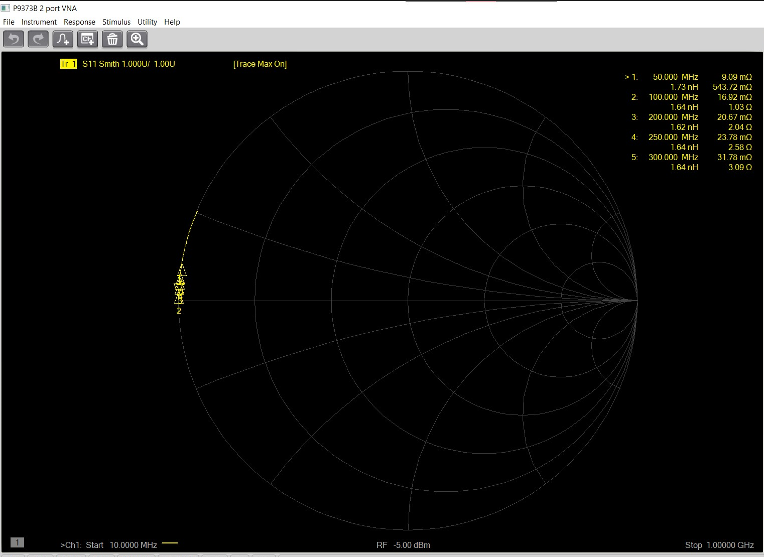
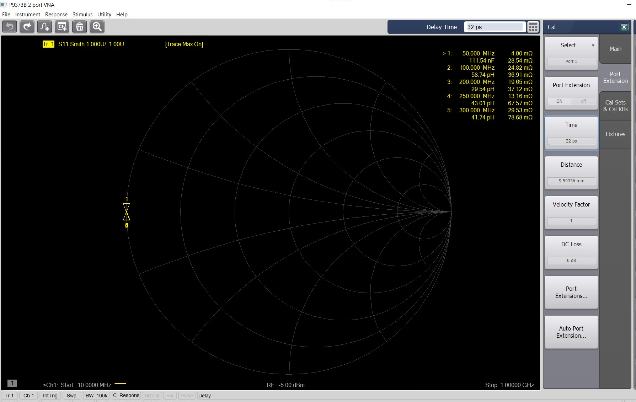
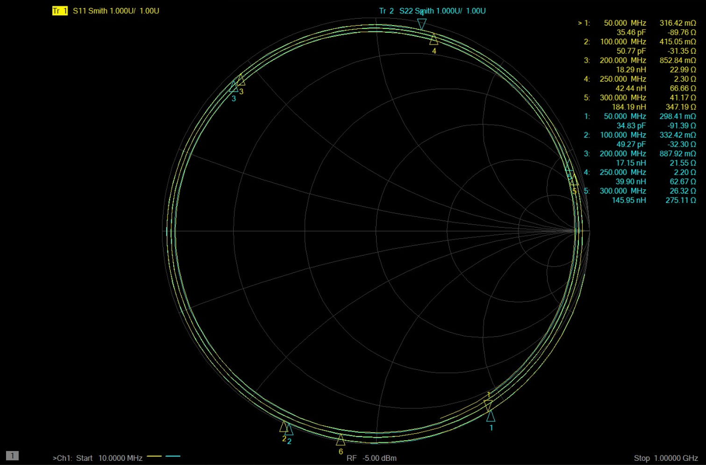
Keysight VNA P9373B Setup – Inductor measurement
Setup span and markers for the desired frequency
For Inductor measurement, calibrate using 0 Ohm resistor
Calibrate port extension to make the marker at 0 Ohm
Measure a known component to fine tune the port extension
The closer value of known component to the DUT, the more accurate the measurement
Short calibration using 0 Ohm resistor
Before calibration
After short calibration
After Port Extension time calibration

Slide 13
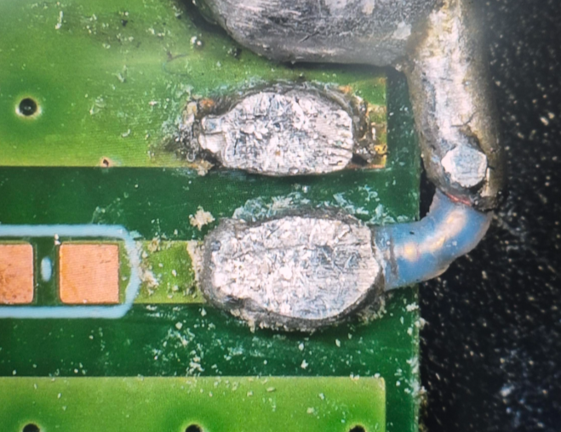
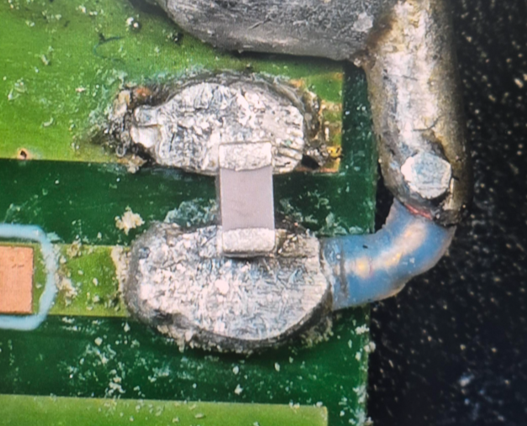
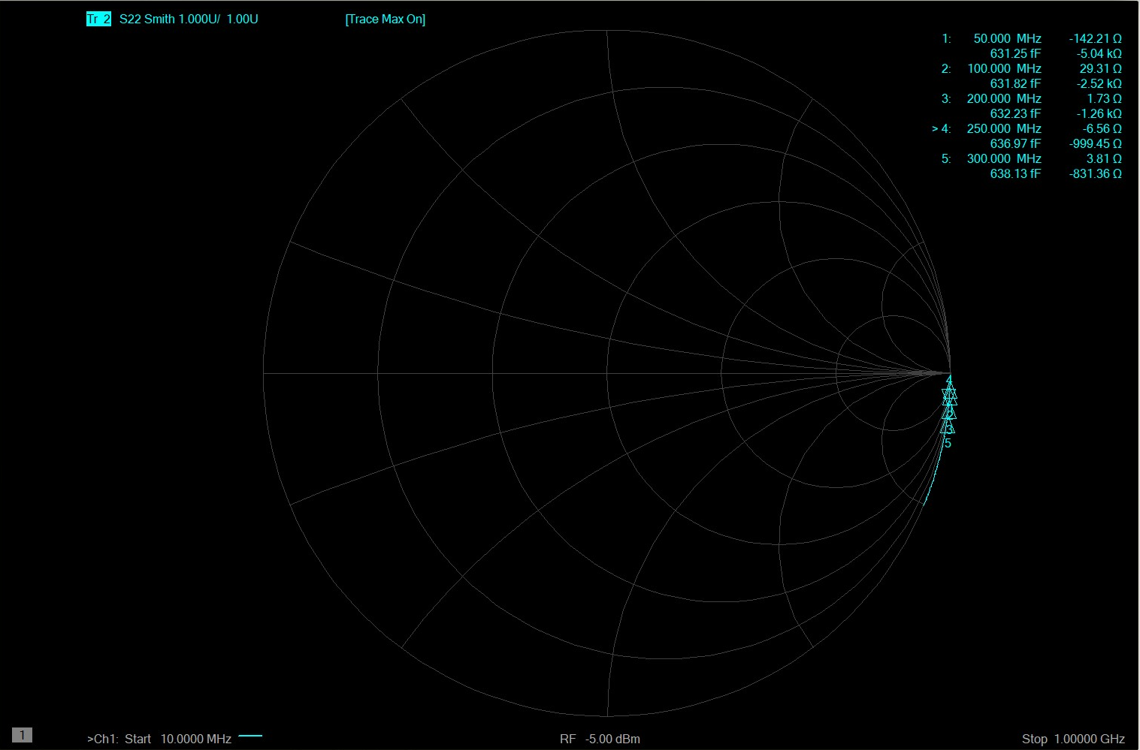
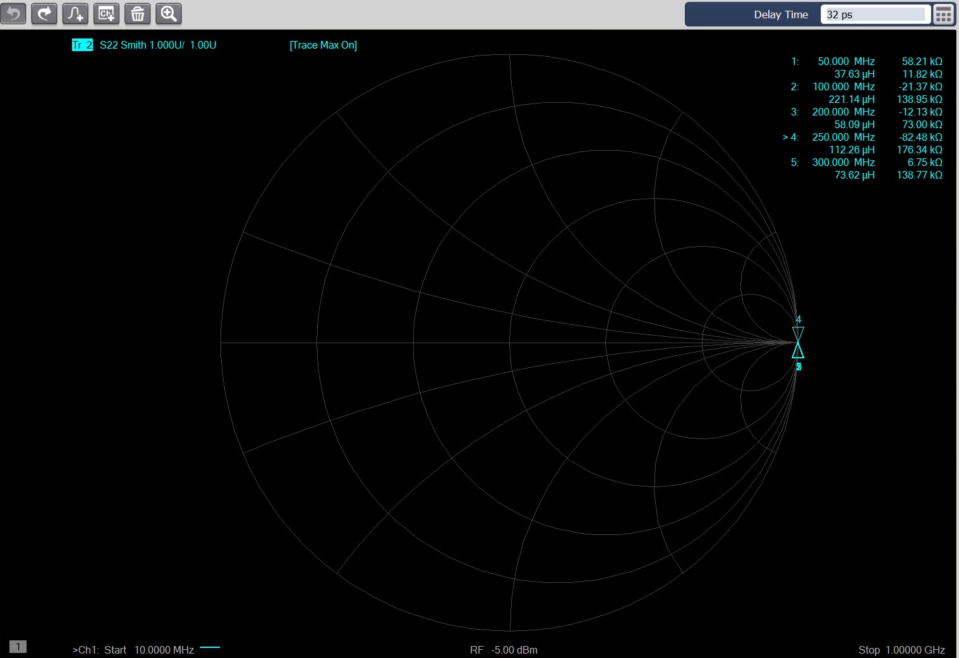
Keysight VNA P9373B Setup – Capacitor measurement
Setup span and markers for the desired frequency
For Capacitor measurement, Open calibration without component
Calibrate port extension to make the marker at 0 Ohm
Measure a known component to fine tune the port extension
The closer value of known component to the DUT, the more accurate the measurement
Open calibration
Capacitor measurement
Before calibration
After open calibration
After Port Extension time calibration

Slide 14
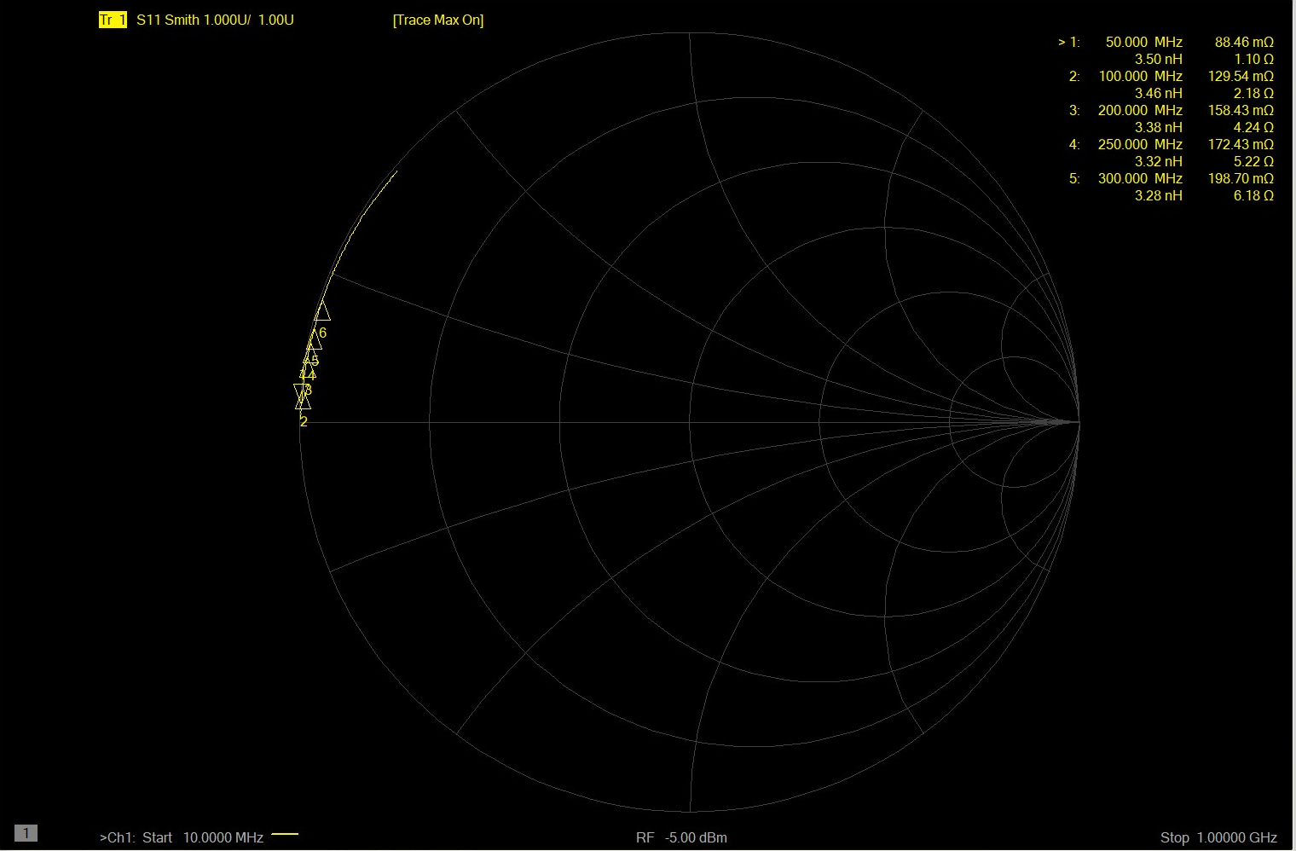
Network Analysis Method – Inductor Measurement
Measuring 3.2nH Inductor from 50MHz to 300MHz

Slide 15
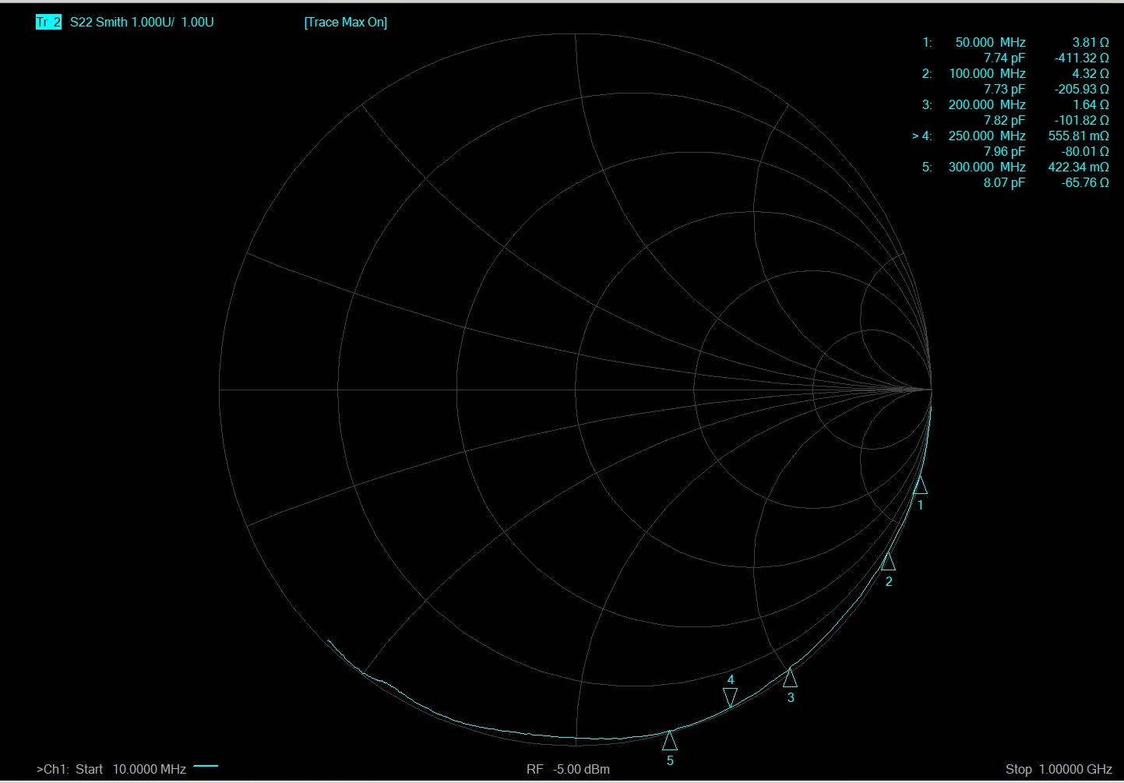
Network Analysis Method – Capacitor Measurement
Measuring 8.2pF Capacitor from 50MHz to 300MHz

Slide 16
Network Analysis Method – Measurement results
Measured 3.3nH, 5.6nH, 27nH, 47nH, 56nH at 250MHz
Measured twice, with 10ps and -28ps Port extension delay
10ps delay is calibrated for 3.3nH
-28ps delay is calibrated for 56nH
Delta and Error is increasing the further the value is from the calibrated value.
Better to calibrate measurement closer to the expected value of DUT

Slide 17
Network Analysis Method – Measurement results
Measured 0.3pF, 1pF, 2.7pF, 8.2pF, 27pF at 250MHz
Measured twice, with 32ps and 56ps Port extension delay
32ps delay is calibrated for 0.3pF
56ps delay is calibrated for 27pF
Delta and Error is increasing the further the value is from the calibrated value.
Better to calibrate measurement closer to the expected value of DUT

Slide 18
Sources
Keysight Impedance Measurement Handbook
Hioki IM3536 Manual
https://www.bkprecision.com/knowledge/how-tos/2/how-to-use-an-lcr-meter

Slide 19


